Slide 1
Perceptron training
Dr. Sifat Momen

Slide 2
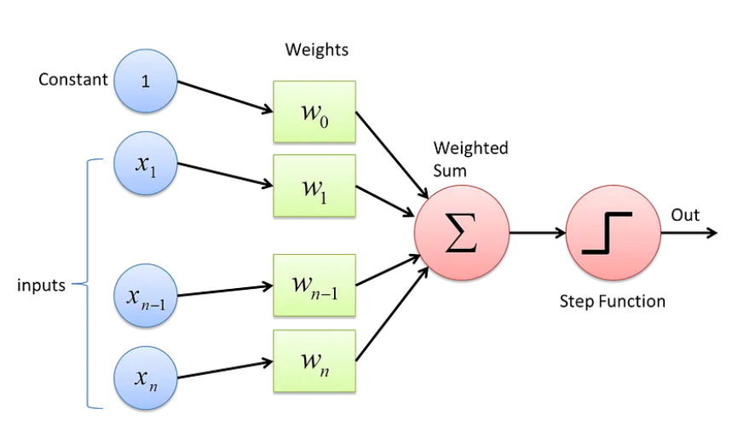
Linear Perceptron Architecture

Slide 3
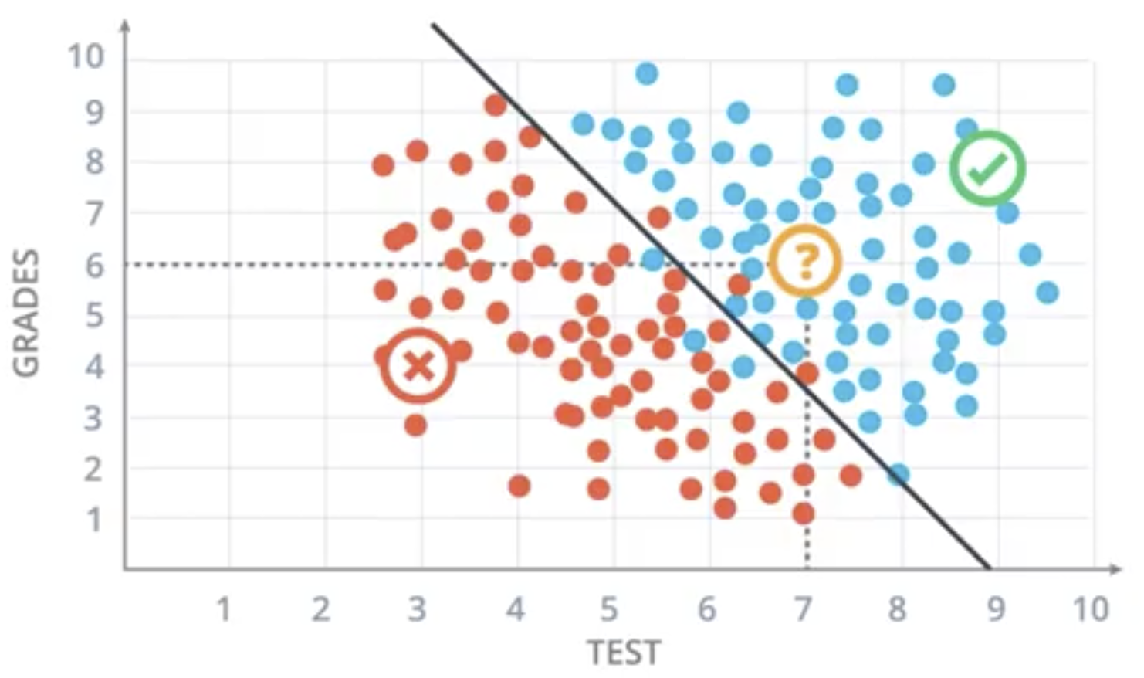
Decision boundary of Linear Perceptron
Ax + By + C = 0

Slide 4
Perceptron Training – idea
We start with a random line (by selecting random values of A, B, and C
We need to shift the decision boundary in such a way that it appropriately shifts the line

Slide 5
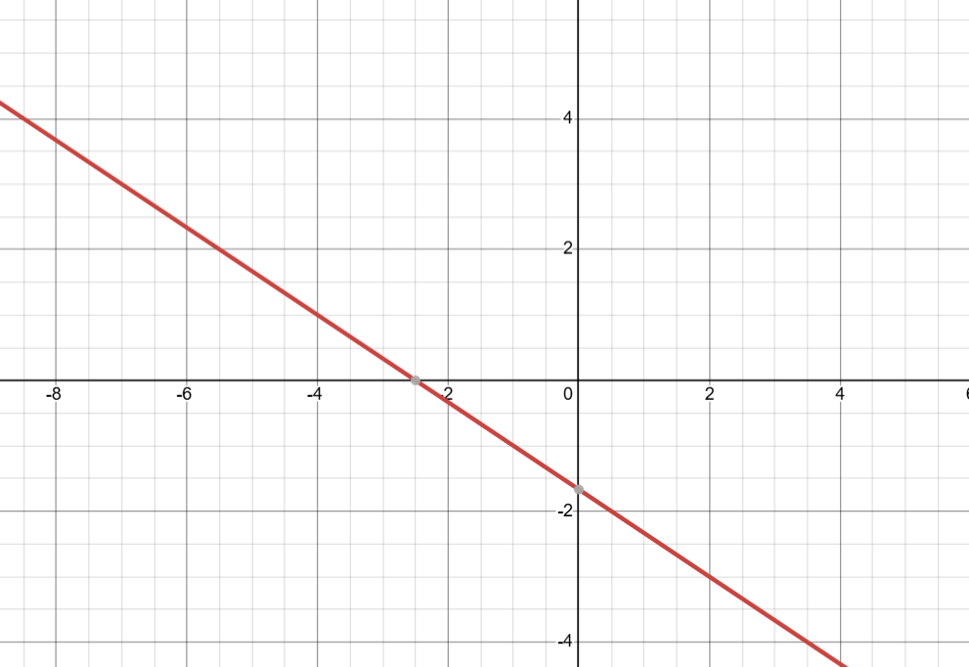
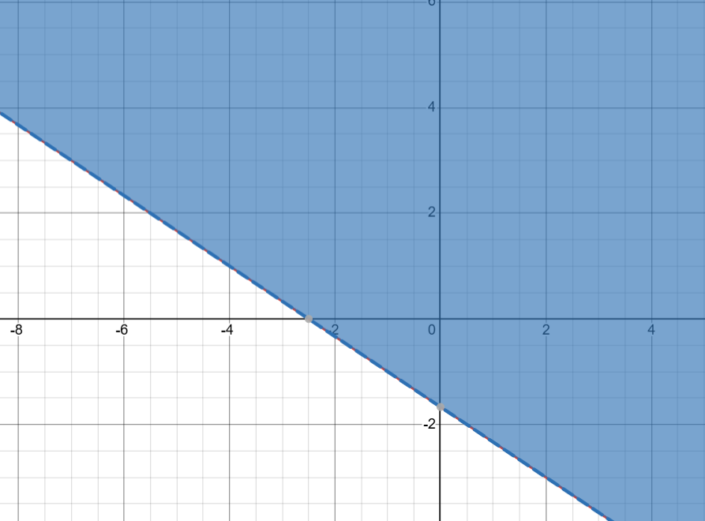
Perceptron Training – idea
2x + 3y + 5 = 0
2x + 3y + 5 > 0

Slide 6
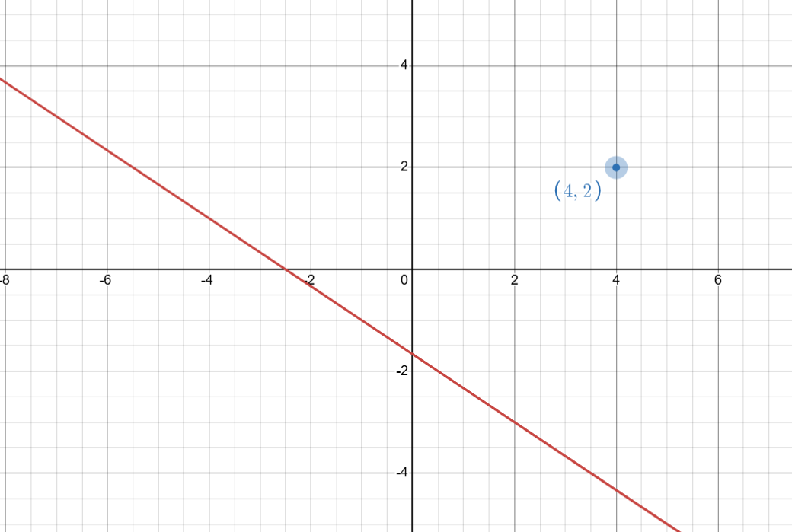
Perceptron Training – idea
Decision boundary: 2x + 3y + 5 = 0
Let us say we have a point, P (4,2) which belongs to a negative class i.e. it was wrongly predicted as a positive class.
We need to shift the decision boundary to the right of the point P.

Slide 7
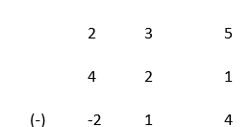
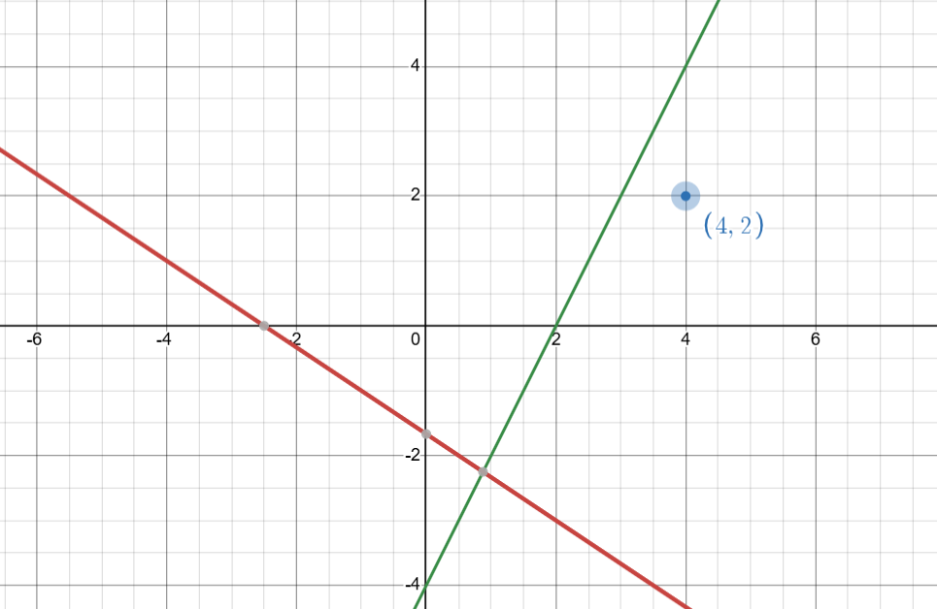
Perceptron Training – idea

Slide 8
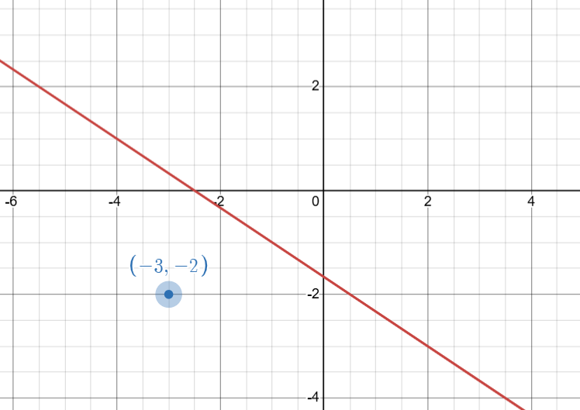
Perceptron Training – idea
Decision boundary: 2x + 3y + 5 = 0
Let us say we have a point, Q (-3,-2) which belongs to a positive class i.e. it was wrongly predicted as a negative class.
We need to shift the decision boundary to the right of the point P.

Slide 9
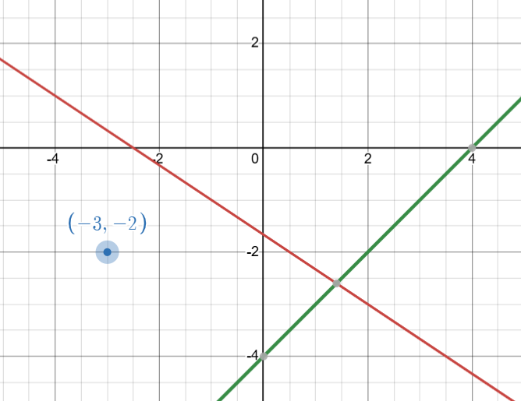
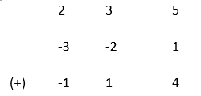
Perceptron Training – idea
Decision boundary: 2x + 3y + 5 = 0
Let us say we have a point, Q (-3,-2) which belongs to a positive class i.e. it was wrongly predicted as a negative class.
We need to shift the decision boundary to the right of the point P.

Slide 10
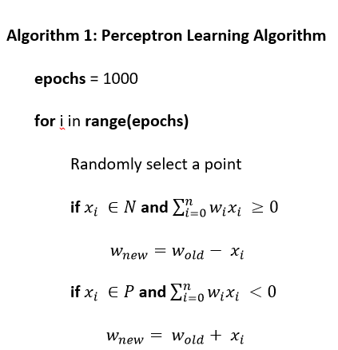
Learning Algorithm
The updates of the bias and weights are too abrupt.
In order to make the learning more gradual, we need to introduce a learning rate, η

Slide 11
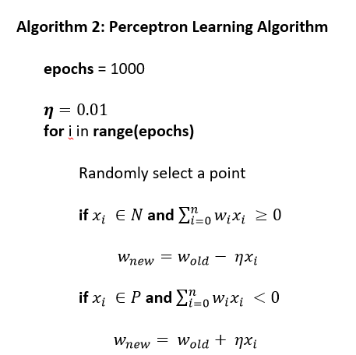
Learning Algorithm

Slide 12
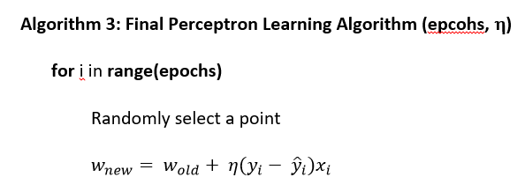
Learning Algorithm

Slide 13
Problems with Perceptron rule / Perceptron trick
Convergence can be slow
If the learning rate (η) is too small, updates take too long.
If η is too large, it may oscillate and never converge.
Limited generalization ability
The perceptron only finds one possible hyperplane, but there are often many valid solutions.
It does not optimize for the best margin, meaning it may not generalize well to new data.

Slide 14
Loss Function
A loss function is a mathematical function that measures how well a machine learning model’s predictions match the actual values. It quantifies the error between predicted outputs and the true labels, guiding the model’s learning process.

Slide 15
Why do we need a loss function?
It evaluates the model's performance by computing the difference between predictions and actual values.
It guides optimization algorithms (like gradient descent) to update the model’s parameters (weights & biases).
A smaller loss means a better model.

Slide 16
Examples of Loss Function
Hinge loss – SVM
Cross Entropy loss / Log loss – Logistic Regression
MSE – Regression
MAE – Regression
Huber Loss – Regression (less sensitive to outliers compared to MSE)

Slide 17
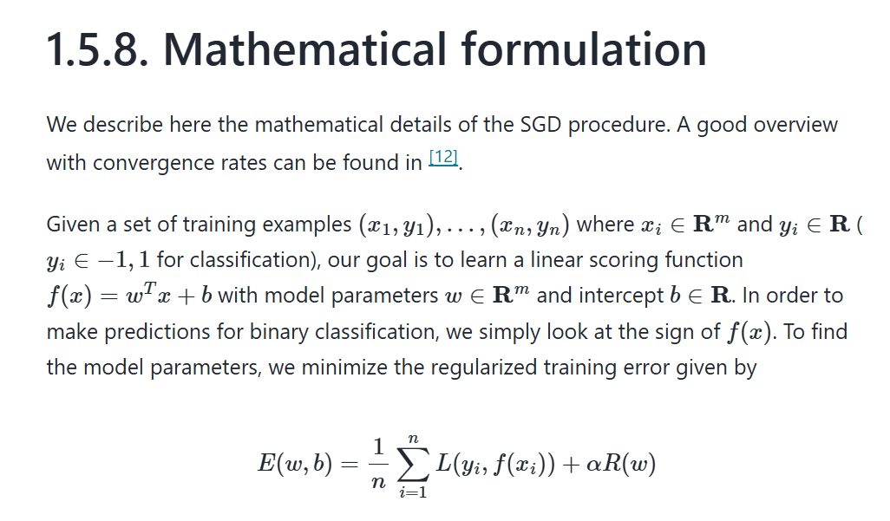
Loss Function (sklearn documentation)
https://scikit-learn.org/stable/modules/sgd.html#

Slide 18
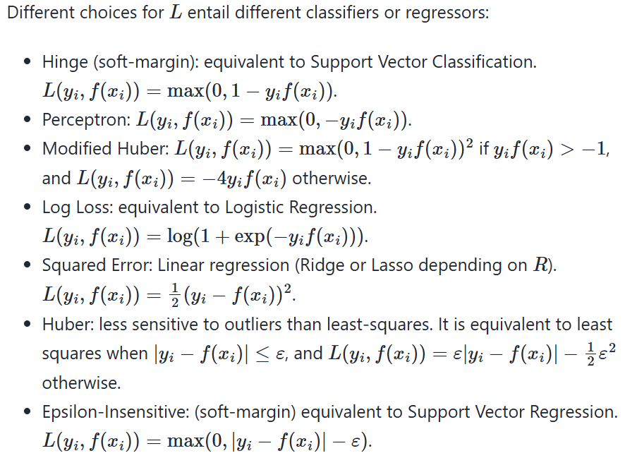
Loss Functions

Slide 19
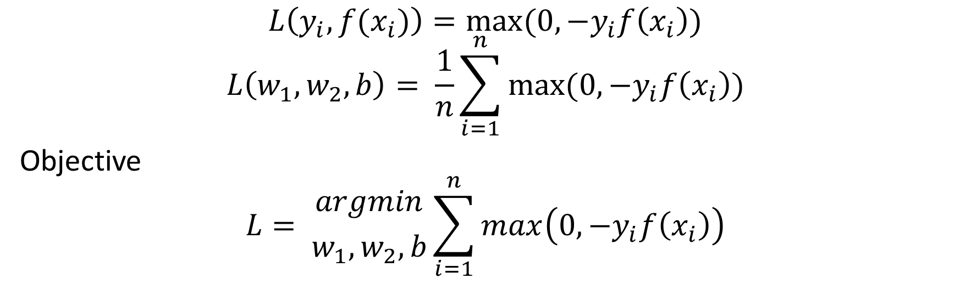
Perceptron Loss Function
$$L\left(y_{i}, f(x_{i})\right)=max(0, −y_{i}f\left(x_{i}\right))$$
$$L\left(w_{1}, w_{2}, b\right)= \frac{1}{n}\sum_{i=1}^{n}{max⁡(0, −y_{i}f\left(x_{i}\right))}$$
Objective
$$L= {argmin \atop w_{1}, w_{2}, b}\sum_{i=1}^{n}{max\left(0, −y_{i}f\left(x_{i}\right)\right)}$$
Gradient descent

Slide 20
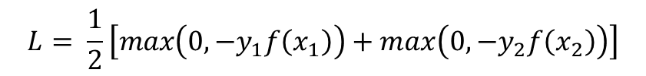
Understanding Perceptron Loss Function
1 | 2
X₁ | X₂ | Y
X₁₁ | X₂₁ | -1/1
X₂₁ | X₂₂ | -1/1
…
X_{i1} | X_{i2} | -1/1
… | … | …
X_{n1} | X_{n2} | -1/1
$$f\left(x_{i}\right)= w_{1}x_{i1}+w_{2}x_{i2}+b$$
For two points
$$L= \frac{1}{2}\left[max\left(0, −y_{1}f\left(x_{1}\right)\right)+max\left(0, −y_{2}f\left(x_{2}\right)\right)\right]$$

Slide 21
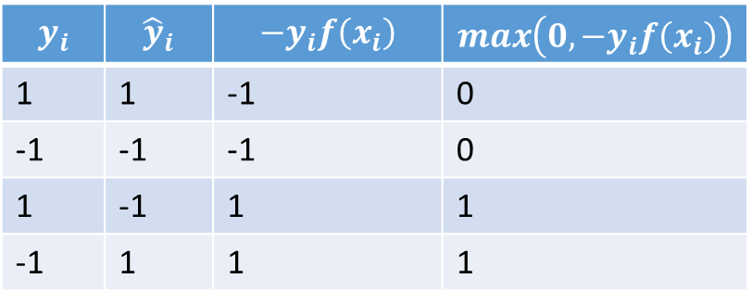
Understanding Perceptron Loss Function
$$y_{i}$$ | $${\hat{y}}_{i}$$ | $$−y_{i}f\left(x_{i}\right)$$ | $$max\left(0, −y_{i}f\left(x_{i}\right)\right)$$
1 | 1 | -1 | 0
-1 | -1 | -1 | 0
1 | -1 | 1 | 1
-1 | 1 | 1 | 1

